Slide 1
COMPETITIVE RECORD · BANKING & FINANCE
CommBank
SAMPLE · RECORD AS AT 8 SEPTEMBER 2026
against Westpac, ANZ, NAB, ING
Record as at 8 September 2026. Every figure below traces to a row in the index.
Index end 8 September 2026. One deck per brand follows: the client first, then each competitor against it.
— The category Take of 8 September 2026 is in review and is not shown.
● observed in the window ◌ not observed — withheld: no defensible figure
RevenuAD Signal

Slide 2
Every ad, by channel
Ads on record for each brand, counted per channel. Observed: each square is a count of dated rows. A blank square is a channel we hold nothing for.
CommBank
Westpac
ANZ
NAB
ING
SAMPLE · RECORD AS AT 8 SEPTEMBER 2026
Meta
1,340
711
844
513
164
as at 24 July 2026
Search
358
239
—
—
34
as at 27 July 2026
Display
54
43
28
40
1
as at 27 July 2026
YouTube
57
120
—
—
—
as at 27 July 2026
LinkedIn
73
83
13
90
5
as at 8 Sept 2026
index · fetched 8 Sept 2026 · query ads by brand and channel, collected cells only, all-time · tier observed · channel dates 24 July 2026 to 8 Sept 2026
RevenuAD Signal

Slide 3
What each brand is leading with
The offer in the copy, read from the ads in the index. Modelled: an extraction, traced to the ad rows it came from.
Brand
Offer
Type
Ads
ANZ
Subscribe to ANZ Institutional Insights for market-leading news and analysis
brand
4
SAMPLE · RECORD AS AT 8 SEPTEMBER 2026
ANZ
Follow ANZ Institutional for market updates
brand
4
CommBank
CommBank Tech Careers - lead tech impacting over 17 million Aussies
brand
28
CommBank
SMSF cash and investment solutions, all in one place
product
3
ING
How leading banks accelerate innovation - ING CTO on architecture
brand
2
ING
Be loud, be proud, be you - WithPride
brand
1
NAB
NAB Low Rate Business Card
product
7
NAB
0% p.a. on business purchases for 12 months with NAB Low Rate Business Card
rate
6
Westpac
Free, award-winning Business Money Tools for tax time
product
8
Westpac
eSaver savings rate of up to 5.25% p.a. for first 5 months
rate
2
anthropic · fetched 8 Sept 2026 · query messages.create model=claude-sonnet-5 ads=40 window=30d to index end · tier modelled
RevenuAD Signal

Slide 4
Who's leading
Share of the ads on record across these 5 brands in the six months to the index end. Observed: a count of dated rows, not a spend share.
ANZ
60% · 527 ads
SAMPLE · RECORD AS AT 8 SEPTEMBER 2026
Westpac
21% · 181 ads
CommBank
10% · 88 ads
NAB
10% · 84 ads
ING
0% · 2 ads
index · ads by advertiser, six months to the index end · 882 ads in the set · tier observed
RevenuAD Signal

Slide 5
What their front pages say
The headline on each home page at capture, and whether it changed since the capture before. Observed: we fetched the page, from the country shown beside the date.
Brand
Headline at capture
Captured
Change
SAMPLE · RECORD AS AT 8 SEPTEMBER 2026
CommBank
“CommBank homepage”
7 Sept 2026 · from AU
first capture
Westpac
“Earn up to 5.75% p.a.”
8 Sept 2026 · from AU
Headline changed from "Westpac - Personal, Business and Corp
ANZ
“Decisions! Decisions! Need help choosing a credit card?”
8 Sept 2026 · from AU
Headline changed from "ANZ Personal – Bank accounts, home lo
NAB
“NAB personal banking”
8 Sept 2026 · from AU
unchanged
ING
“Save like there's lots of tomorrows.”
8 Sept 2026 · from AU
unchanged
self_hosted_fetch · fetched 8 Sept 2026 · query GET https://www.<domain>/ headless chrome 1440x900, hashed headline + body text · tier observed · exit AU (apify_residential_au)
RevenuAD Signal

Slide 6
LinkedIn
Creatives under each brand in the public LinkedIn Ad Library, last 30 days, Australia. Observed: we fetched the library; the library's own count sits beside ours. LinkedIn publishes no dates, so a row is dated by our fetch.
Brand
Library says
We hold
Latest copy
Fetched
SAMPLE · RECORD AS AT 8 SEPTEMBER 2026
CommBank
100
73
At CommBank, collaboration, growth and meaningful work go hand in hand. Join a community that backs
8 Sept 2026 · from AU
Westpac
94
83
Looking for a bank that understands agribusiness? We’ll offer you tailored solutions so you can move
8 Sept 2026 · from AU
ANZ
311
13
Subscribe to ANZ Institutional Insights to get the latest market-leading news, analysis and thought
7 Sept 2026 · from AU
NAB
118
90
Keep more of your money for what matters. With a NAB Business Everyday Account, you'll pay no monthl
8 Sept 2026 · from AU
ING
123
5
What determines the speed of innovation in a modern bank: strategy, technology or architecture? In t
8 Sept 2026 · from AU
linkedin_ad_library_page · fetched 8 Sept 2026 · query accountOwner=<brand> dateOption=last-30-days countries=AU maxAds=400 via apify residential AU · tier observed · exit AU (apify_residential_au)
RevenuAD Signal

Slide 7
Demand against supply
Search interest for the category's buyer terms (Google Trends, 0-100 against each term's own peak) beside the ads these brands ran in the same weeks.
Term
Last 13 wks
Prior 13 wks
Shift
Latest wk
SAMPLE · RECORD AS AT 8 SEPTEMBER 2026
credit card
91
89
flat +1.9
65
home loan
80
85
▼ 4.5
49
personal loan
86
91
▼ 5.5
57
savings account
83
84
flat -1.2
49
term deposit
73
81
▼ 7.3
52
Supply: 331 new creatives from CommBank, Westpac, ANZ, NAB, ING first seen in the last 13 weeks to the index end, against 198 in the 13 before (+67%); 926 active in the window. Observed rows.
google_trends · fetched 7 Sept 2026 · query explore geo=AU time="today 12-m" keyword=<term> · tier reported · series to the week before fetch, weekly
RevenuAD Signal

Slide 8
Site traffic beside ad volume
Monthly visits to each brand's site (Similarweb estimate, reported) next to the ads we observed for the brand in the six months to the index end.
Brand
Visits, latest month
vs prior month
Ads observed, 6 mo
Traffic as at
SAMPLE · RECORD AS AT 8 SEPTEMBER 2026
CommBank
17,145,875 (August 2026)
-2.8%
88
8 Sept 2026
Westpac
11,897,909 (August 2026)
-1.4%
181
8 Sept 2026
ANZ
7,910,762 (August 2026)
-1.5%
527
8 Sept 2026
NAB
12,390,925 (August 2026)
-0.3%
84
8 Sept 2026
ING
3,156,452 (August 2026)
-9%
2
8 Sept 2026
apify:radeance/similarweb-scraper · fetched 8 Sept 2026 · query urls=<domain> include_base_data include_similar_sites include_indepth_data · tier reported
RevenuAD Signal

Slide 9
Modelled spend
A range appears only where the model passes its five tests on the month reported. Otherwise the dash and the reason. Modelled, and marked as such.
CommBank
— Reach data covers 21% of this brand's priced ads. A range is published at 50% or more.
SAMPLE · RECORD AS AT 8 SEPTEMBER 2026
Westpac
— Reach data covers 38% of this brand's priced ads. A range is published at 50% or more.
ANZ
— Reach data covers 25% of this brand's priced ads. A range is published at 50% or more.
NAB
— Reach data covers 46% of this brand's priced ads. A range is published at 50% or more.
ING
— Reach data covers 45% of this brand's priced ads. A range is published at 50% or more.
utils/spend-estimate.js DEFENSIBLE: reach coverage, span coverage, sample, reach share, calibration · tier modelled
RevenuAD Signal

Slide 10

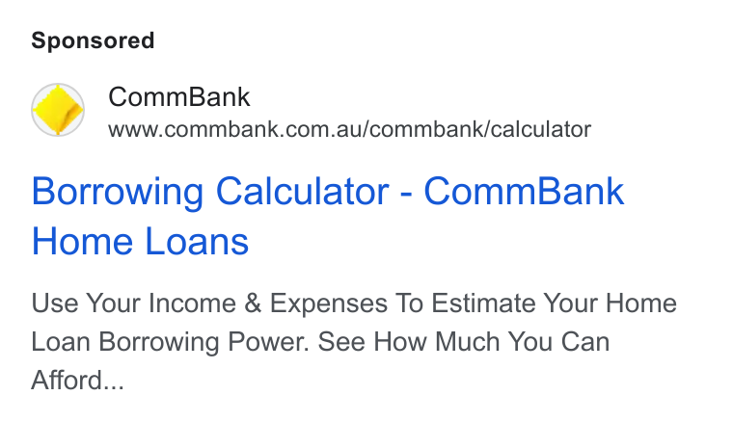
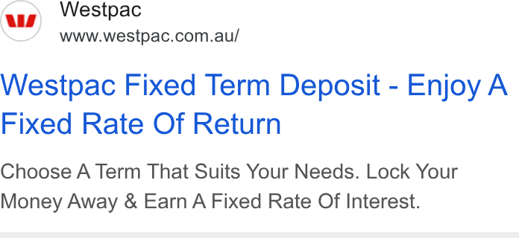
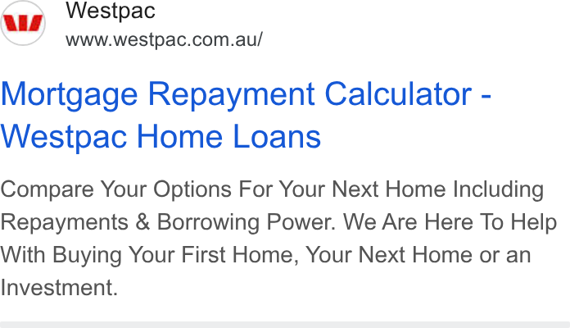
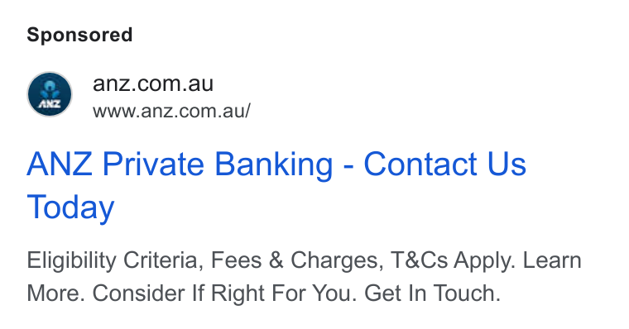
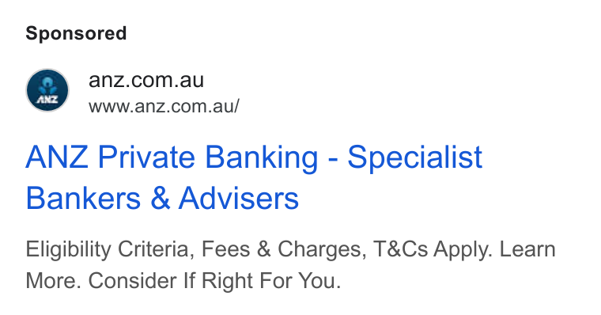
The ad wall, a sample
Six creatives from the record, one row each, dated by our own sightings. Observed.
SAMPLE · RECORD AS AT 8 SEPTEMBER 2026
CommBank · Google Search · 4 Oct 2022 to 22 June 2026 · #756
CommBank · Google Search · 25 Mar 2024 to 22 June 2026 · #755
Westpac · Google Search · 4 Nov 2022 to 22 June 2026 · #738
Westpac · Google Search · 10 Nov 2025 to 22 June 2026 · #737
ANZ · Google Search · 31 Jan 2024 to 22 June 2026 · #730
ANZ · Google Search · 31 Jan 2024 to 22 June 2026 · #729
index · creatives with a stored image, most-sighted first, two a brand · #id is the library row · tier observed
RevenuAD Signal

Slide 11
How to read this deck
Every figure carries one of three marks. Two rules sit under all of them.
● Observed
We saw it ourselves, on a named date: an ad counted, a page captured, a library read. If the count is wrong it is our fault and we can show the run.
SAMPLE · RECORD AS AT 8 SEPTEMBER 2026
▨ Modelled
We worked it out. A spend range shows only where five tests pass on the month reported; otherwise a dash and the reason.
○ Reported
The platform said so and we could not check it: a start date, a search-interest index, a visits estimate, a rank. Passed through unchanged and marked.
Rule 1
Each channel is dated at its own index end. When the dates differ, the slide says so.
Rule 2
A captured page carries the country it was fetched from. Public surfaces show Australian captures only.
channel index ends: YouTube 27 July 2026 · LinkedIn 8 Sept 2026 · Search 27 July 2026 · Meta 24 July 2026 · Display 27 July 2026
RevenuAD Signal

Slide 12
What we can't see
Named, so no square in this deck is mistaken for the whole market.
◌ Snap, Reddit, X, Pinterest
No public ad library for Australia.
SAMPLE · RECORD AS AT 8 SEPTEMBER 2026
◌ Audio, TV, outdoor
No public record of who ran what.
◌ TikTok, per brand
We read TikTok's own top-ads list; we cannot count a brand's TikTok ads.
◌ Facebook against Instagram
The platform is recorded on 3% of Meta ads, so Meta stays one row.
◌ Results
We count that an ad ran, not what it achieved.
◌ Spend, most of the time
A range shows only where the model holds; today that is rare, and the dash says why.
RevenuAD Signal

Slide 13
SAMPLE · RECORD AS AT 8 SEPTEMBER 2026
Appendix: the full record
One deck per brand follows: the client first, then each competitor against it. Every slide carries its own dates and marks.

Slide 14
SAMPLE · RECORD AS AT 8 SEPTEMBER 2026
CommBank
General Banking · Record as at 8 September 2026
RevenuAD Signal

Slide 15
Where they're active
Each channel is read as at its own index end: YouTube, Google Search, Programmatic Display as at 27 July 2026; Meta as at 24 July 2026; TikTok, LinkedIn as at 8 Sept 2026.
● YouTube
◌ TikTok · Not observed
SAMPLE · RECORD AS AT 8 SEPTEMBER 2026
as at 27 July 2026
as at 8 Sept 2026
● Google Search
● LinkedIn
as at 27 July 2026
as at 8 Sept 2026
● Meta
● Programmatic Display
as at 24 July 2026
as at 27 July 2026
RevenuAD Signal

Slide 16
Spend signal
SAMPLE · RECORD AS AT 8 SEPTEMBER 2026
—
Reach data covers 21% of this brand's priced ads. A range is published at 50% or more.
Spend range withheld
RevenuAD Signal

Slide 17
What they're saying
Financial Services
Savings
Home Loans
Banking
Accessibility
SAMPLE · RECORD AS AT 8 SEPTEMBER 2026
RevenuAD Signal

Slide 18
Products & audiences
PRODUCTS BEING PROMOTED
AUDIENCES / PERSONAS
• Smart EFTPOS Terminal
• CommBank Payments
• CommBank Everyday account
• CommBank Business Transaction Account
• Ultimate Awards Credit Card
• Personal Loans
• Merchants
• Small Business Owners
• Existing Customers
• Existing Commbank Customers
• Professionals
• Rate Conscious Consumers
SAMPLE · RECORD AS AT 8 SEPTEMBER 2026
RevenuAD Signal

Slide 19
The opportunity
CommBank has no presence on TikTok
SAMPLE · RECORD AS AT 8 SEPTEMBER 2026
RevenuAD Signal

Slide 20
Where to play
1. Activate on TikTok
SAMPLE · RECORD AS AT 8 SEPTEMBER 2026
2. Target the audience segments CommBank isn't reaching
3. Own the "Financial Services" message before competitors do
Powered by RevenuAD Signal

Slide 21
Share of voice
CommBank vs Westpac
SAMPLE · RECORD AS AT 8 SEPTEMBER 2026
52.3%
47.7%
CommBank
Westpac
Based on tracked placements across tracked channels, last 14 days (n=1,054). A share of the ads we counted, not a media-buy audit. General Banking · Record as at 8 September 2026
RevenuAD Signal

Slide 22
Where they're active
Each channel is read as at its own index end: YouTube, Google Search, Programmatic Display as at 27 July 2026; Meta as at 24 July 2026; TikTok, LinkedIn as at 8 Sept 2026.
● YouTube
◌ TikTok · Not observed
SAMPLE · RECORD AS AT 8 SEPTEMBER 2026
as at 27 July 2026
as at 8 Sept 2026
● Google Search
● LinkedIn
as at 27 July 2026
as at 8 Sept 2026
● Meta
● Programmatic Display
as at 24 July 2026
as at 27 July 2026
RevenuAD Signal

Slide 23
Spend signal
SAMPLE · RECORD AS AT 8 SEPTEMBER 2026
—
Reach data covers 38% of this brand's priced ads. A range is published at 50% or more.
Spend range withheld
RevenuAD Signal

Slide 24
What they're saying
Financial Services
Banking
Home Loans
Savings
Digital Banking
SAMPLE · RECORD AS AT 8 SEPTEMBER 2026
RevenuAD Signal

Slide 25
Products & audiences
PRODUCTS BEING PROMOTED
AUDIENCES / PERSONAS
• Business Account
• Westpac App
• Payee Verification
• Fraud Defence
• Westpac Online Banking
• Westpac Rewards
• Small Business Owners
• Business Decision Makers
• Business Account Holders
• SME decision makers
• Existing Customers
• Institutional Clients
SAMPLE · RECORD AS AT 8 SEPTEMBER 2026
RevenuAD Signal

Slide 26
The opportunity
Westpac has no presence on TikTok
SAMPLE · RECORD AS AT 8 SEPTEMBER 2026
RevenuAD Signal

Slide 27
Where to play
1. Activate on TikTok
SAMPLE · RECORD AS AT 8 SEPTEMBER 2026
2. Target the audience segments Westpac isn't reaching
3. Own the "Financial Services" message before competitors do
Powered by RevenuAD Signal

Slide 28
Share of voice
CommBank vs ANZ
SAMPLE · RECORD AS AT 8 SEPTEMBER 2026
79.9%
20.1%
CommBank
ANZ
Based on tracked placements across tracked channels, last 14 days (n=690). A share of the ads we counted, not a media-buy audit. General Banking · Record as at 8 September 2026
RevenuAD Signal

Slide 29
Where they're active
Each channel is read as at its own index end: YouTube, Google Search, Programmatic Display as at 27 July 2026; Meta as at 24 July 2026; TikTok, LinkedIn as at 8 Sept 2026.
● YouTube
◌ TikTok · Not observed
SAMPLE · RECORD AS AT 8 SEPTEMBER 2026
as at 27 July 2026
as at 8 Sept 2026
◌ Google Search · Not observed
● LinkedIn
as at 27 July 2026
as at 8 Sept 2026
● Meta
● Programmatic Display
as at 24 July 2026
as at 27 July 2026
RevenuAD Signal

Slide 30
Spend signal
SAMPLE · RECORD AS AT 8 SEPTEMBER 2026
—
Reach data covers 25% of this brand's priced ads. A range is published at 50% or more.
Spend range withheld
RevenuAD Signal

Slide 31
What they're saying
Financial Services
Banking
Savings
Convenience
Peace Of Mind
SAMPLE · RECORD AS AT 8 SEPTEMBER 2026
Primary CTA: Donate now
RevenuAD Signal

Slide 32
Products & audiences
PRODUCTS BEING PROMOTED
AUDIENCES / PERSONAS
• ANZ Plus app
• ANZ Home Insurance Plus Cover
• ANZ Plus account
• ANZ Car Insurance
• Home Loans
• ANZ Home Insurance
• Homeowners
• Entrepreneurs
• Small Business Owners
• Professionals
• Property Investors
• 25-55 Age Group
SAMPLE · RECORD AS AT 8 SEPTEMBER 2026
RevenuAD Signal

Slide 33
The opportunity
ANZ has no presence on Google Search, TikTok
SAMPLE · RECORD AS AT 8 SEPTEMBER 2026
RevenuAD Signal

Slide 34
Where to play
1. Activate on Google Search
SAMPLE · RECORD AS AT 8 SEPTEMBER 2026
2. Target the audience segments ANZ isn't reaching
3. Own the "Financial Services" message before competitors do
Powered by RevenuAD Signal

Slide 35
Share of voice
CommBank vs NAB
SAMPLE · RECORD AS AT 8 SEPTEMBER 2026
59.2%
40.8%
CommBank
NAB
Based on tracked placements across tracked channels, last 14 days (n=931). A share of the ads we counted, not a media-buy audit. General Banking · Record as at 8 September 2026
RevenuAD Signal

Slide 36
Where they're active
Each channel is read as at its own index end: YouTube, Google Search, Programmatic Display as at 27 July 2026; Meta as at 24 July 2026; TikTok, LinkedIn as at 8 Sept 2026.
● YouTube
◌ TikTok · Not observed
SAMPLE · RECORD AS AT 8 SEPTEMBER 2026
as at 27 July 2026
as at 8 Sept 2026
◌ Google Search · Not observed
● LinkedIn
as at 27 July 2026
as at 8 Sept 2026
● Meta
● Programmatic Display
as at 24 July 2026
as at 27 July 2026
RevenuAD Signal

Slide 37
Spend signal
SAMPLE · RECORD AS AT 8 SEPTEMBER 2026
—
Reach data covers 46% of this brand's priced ads. A range is published at 50% or more.
Spend range withheld
RevenuAD Signal

Slide 38
What they're saying
Finance
Financial Services
Banking
Rewards
Financial Services
SAMPLE · RECORD AS AT 8 SEPTEMBER 2026
RevenuAD Signal

Slide 39
Products & audiences
PRODUCTS BEING PROMOTED
AUDIENCES / PERSONAS
• NAB Low Rate Card
• Personal Banking
• Insurance
• Loans
• Accounts
• Credit Cards
• Entrepreneurs
• existing NAB customers
• Business Decision Makers
• Small Business Owners
• Credit Card Seekers
• Australian consumers
SAMPLE · RECORD AS AT 8 SEPTEMBER 2026
RevenuAD Signal

Slide 40
The opportunity
NAB has no presence on Google Search, TikTok
SAMPLE · RECORD AS AT 8 SEPTEMBER 2026
RevenuAD Signal

Slide 41
Where to play
1. Activate on Google Search
SAMPLE · RECORD AS AT 8 SEPTEMBER 2026
2. Target the audience segments NAB isn't reaching
3. Own the "Finance" message before competitors do
Powered by RevenuAD Signal

Slide 42
Share of voice
CommBank vs ING
SAMPLE · RECORD AS AT 8 SEPTEMBER 2026
86.2%
13.8%
CommBank
ING
Based on tracked placements across tracked channels, last 14 days (n=639). A share of the ads we counted, not a media-buy audit. General Banking · Record as at 8 September 2026
RevenuAD Signal

Slide 43
Where they're active
Each channel is read as at its own index end: YouTube, Google Search, Programmatic Display as at 27 July 2026; Meta as at 24 July 2026; TikTok, LinkedIn as at 8 Sept 2026.
● YouTube
◌ TikTok · Not observed
SAMPLE · RECORD AS AT 8 SEPTEMBER 2026
as at 27 July 2026
as at 8 Sept 2026
◌ Google Search · Not observed
● LinkedIn
as at 27 July 2026
as at 8 Sept 2026
● Meta
◌ Programmatic Display · Not observed
as at 24 July 2026
as at 27 July 2026
RevenuAD Signal

Slide 44
Spend signal
SAMPLE · RECORD AS AT 8 SEPTEMBER 2026
—
Reach data covers 45% of this brand's priced ads. A range is published at 50% or more.
Spend range withheld
RevenuAD Signal

Slide 45
What they're saying
Value Proposition
Cashback
Financial Benefits
Savings
Social Proof
SAMPLE · RECORD AS AT 8 SEPTEMBER 2026
Primary CTA: See details
RevenuAD Signal

Slide 46
Products & audiences
PRODUCTS BEING PROMOTED
AUDIENCES / PERSONAS
• ING Pocket Perks
• Orange Everyday
• Orange Everyday account
• ING transaction account
• ING Savings Accelerator
• international ATM access
• Australian consumers
• Utility Bill Payers
• International Travelers
• Existing Bank Customers
• Banking Customers
• Frequent International Travelers
SAMPLE · RECORD AS AT 8 SEPTEMBER 2026
RevenuAD Signal

Slide 47
The opportunity
ING has no presence on TikTok
SAMPLE · RECORD AS AT 8 SEPTEMBER 2026
RevenuAD Signal

Slide 48
Where to play
1. Activate on TikTok
SAMPLE · RECORD AS AT 8 SEPTEMBER 2026
2. Target the audience segments ING isn't reaching
3. Own the "Value Proposition" message before competitors do
Powered by RevenuAD Signal

